Slide 1
ECE 445 Team 1:
Waste Bin Monitoring System
Matt Rylander, Allen Steinberg, Ben Gao

Slide 2
Matt
Allen
Ben
DELETE THIS SLIDE WHEN WE ARE DONE
Introduction to your team and your project.
Objective. What problem are you solving?
Brief review of original design, statement on areas of design that changed, and overview of each functional block's requirements.
Description of project build and functional test results. You can choose to include a short (30s) video of your project here.
Discussion of successes and challenges, as well as explanations of any failed verifications demonstrating and understanding of the engineering reason behind the failure
Conclusions from the project: what did you learn, what would you do differently if you redesigned your project, etc.
Recommendations for further work.
Any significant, relevant ethical issues should be briefly addressed, preferably in a single slide. (Both Allen and Ben)

Slide 3
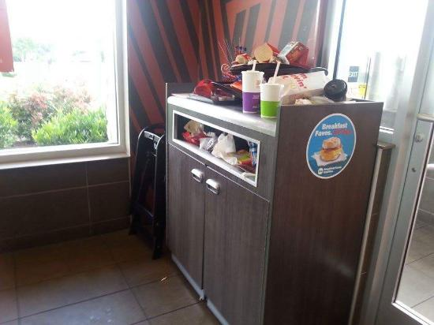
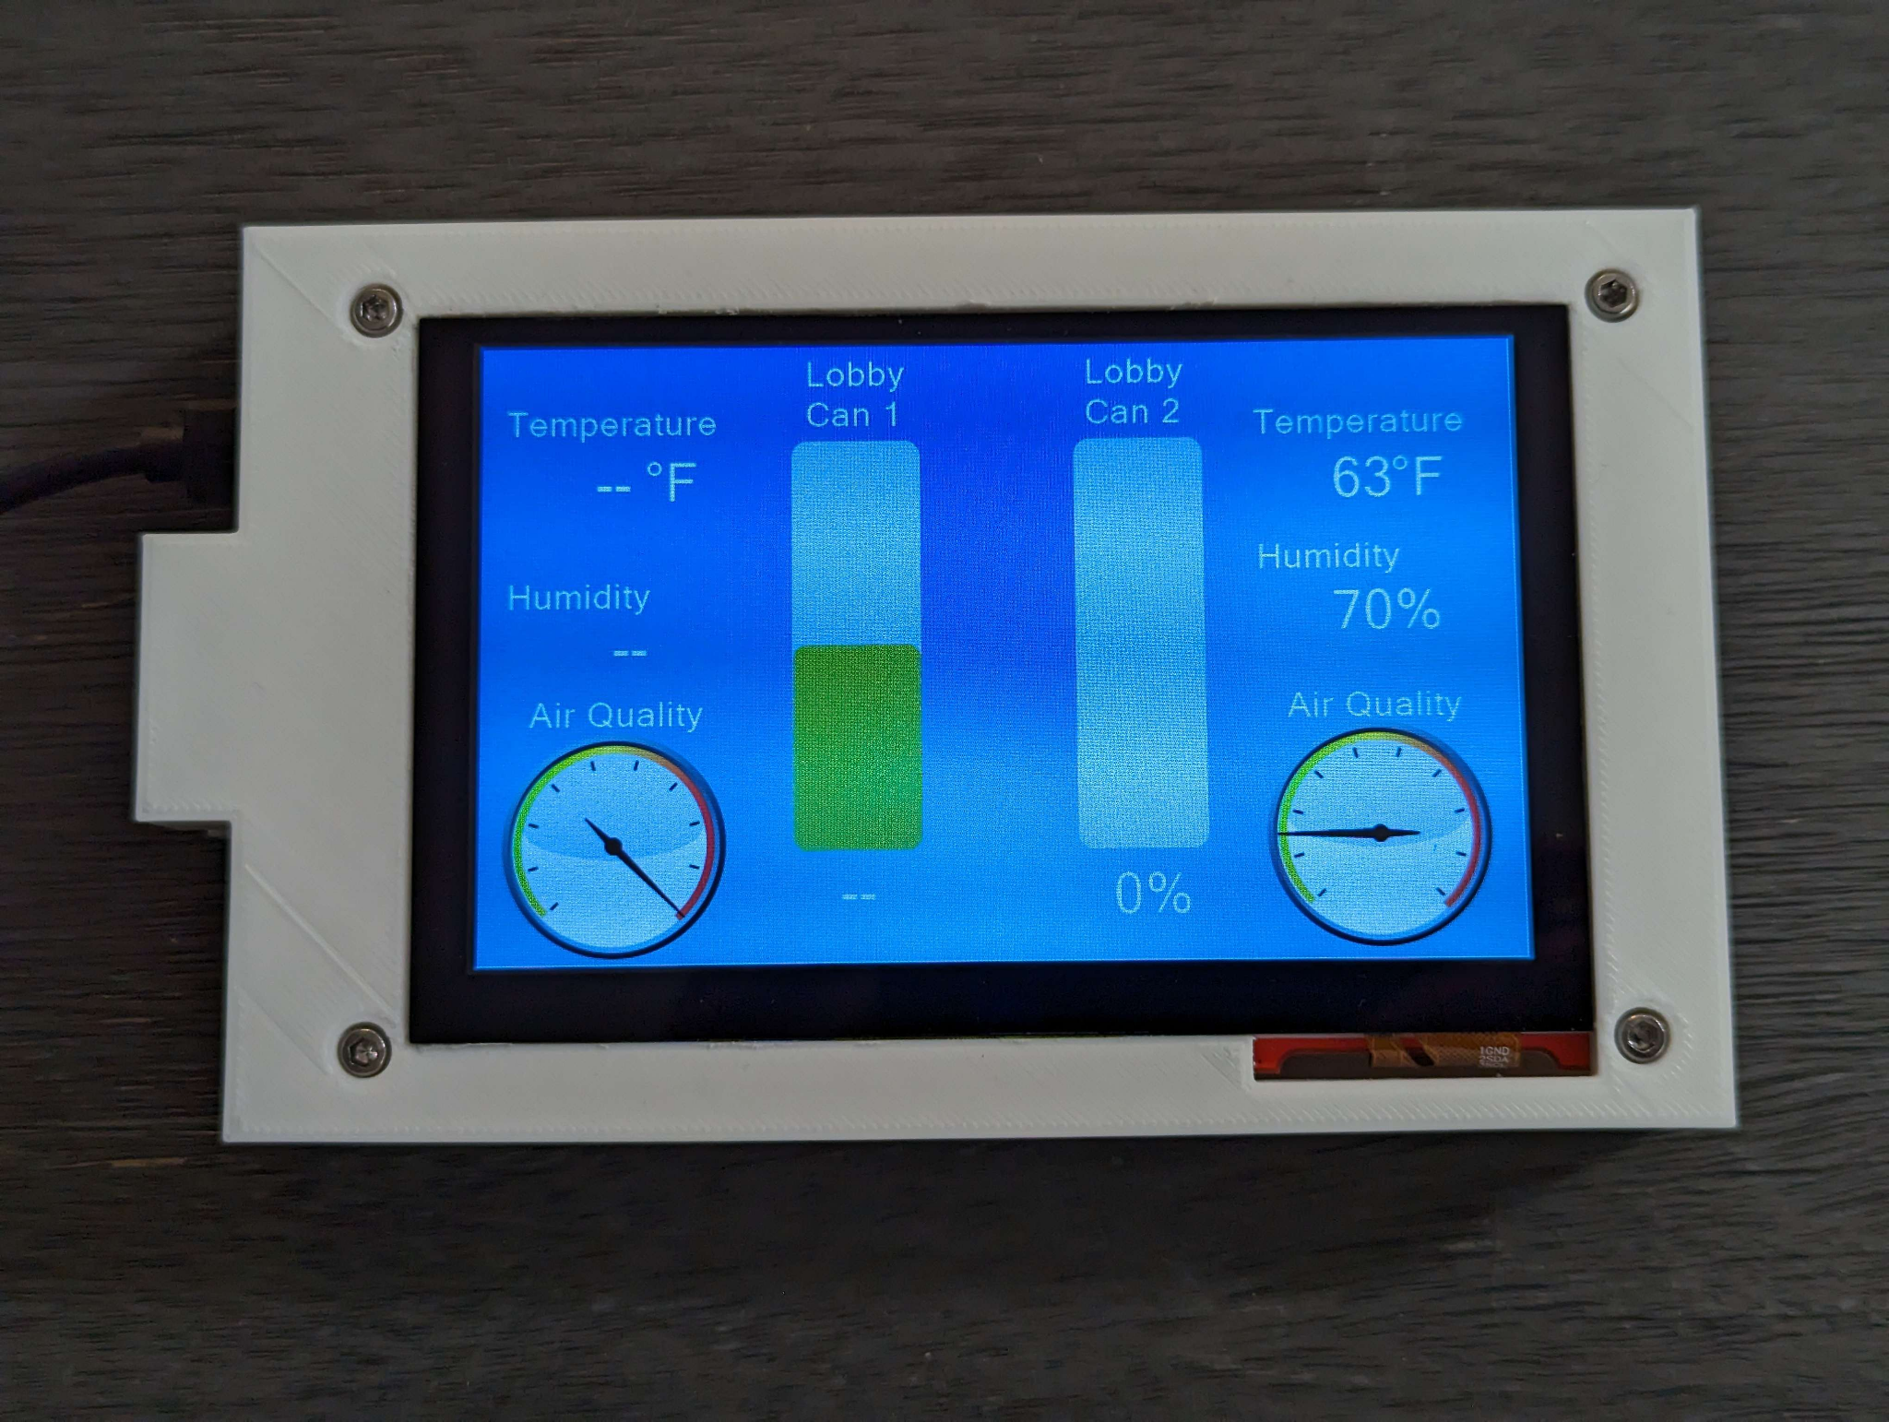
Introduction
Notes:
Matt

Slide 4

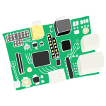


Objective
Sensor tags on trash cans
Central hub for restaurant staff
Simple-as-possible setup and wireless comms.
Notes:
Allen

Slide 5
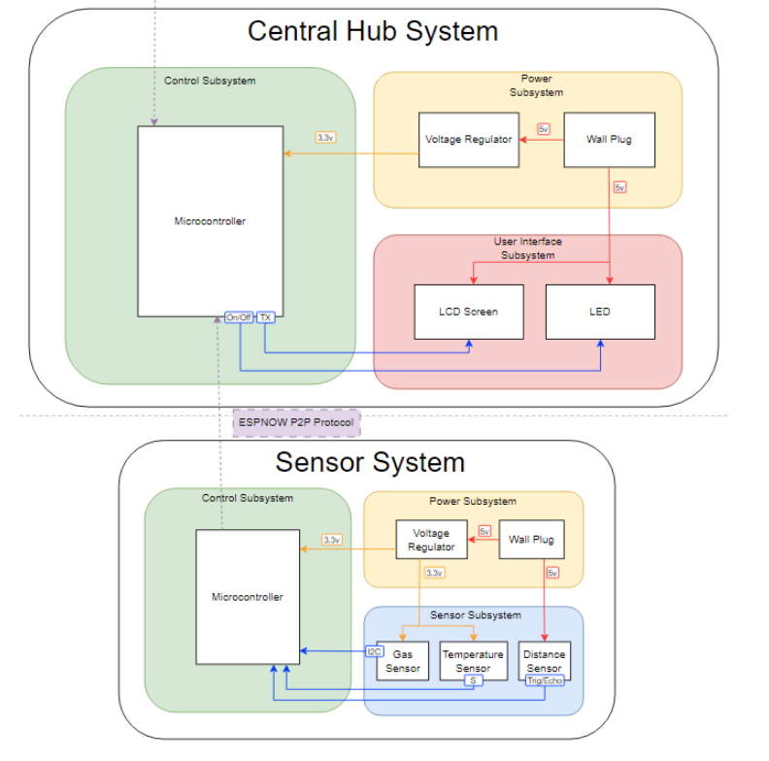
Original Design Overview
Notes:
Ben
Brief review of original design, statement on areas of design that changed, and overview of each functional block's requirements.

Slide 6
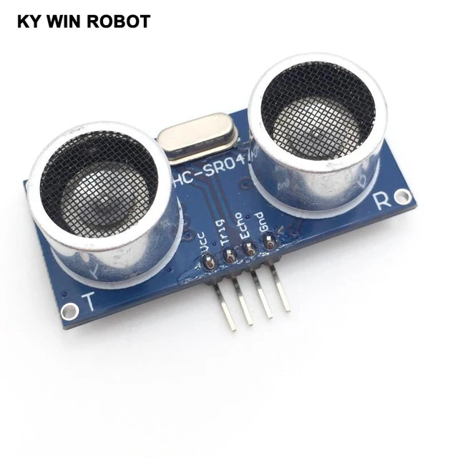
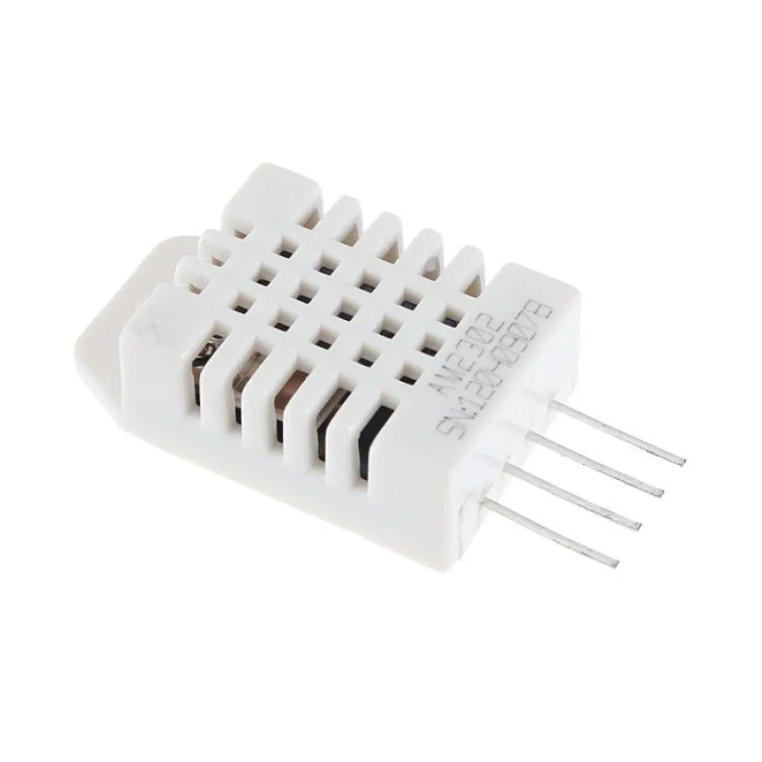
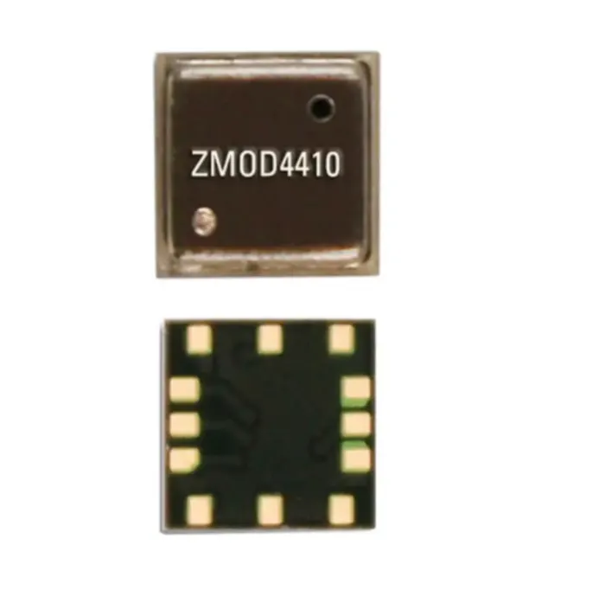
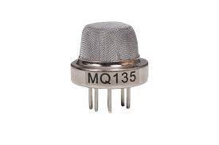
Subsystems
Sensor subsystem:
HC-SR04 Ultrasonic
DHT-22 Temperature/Humidity
ZMOD4410 Gas Sensor
Found unsuitable (details on later slide)
Changed gas sensor to MQ-135 Gas Sensor
Notes:
Ben

Slide 7
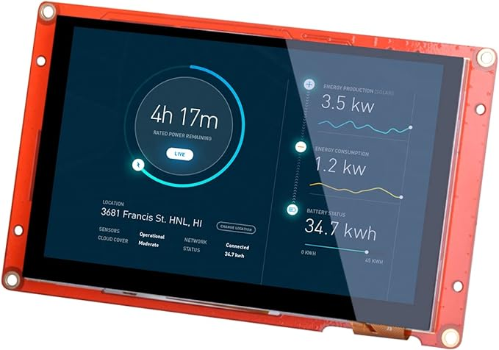
Subsystems
(cont.)
Power subsystems: 5V->3V3 regulator
Control subsystem: ESP-32
User Interface Subsystem:
Nextion LCD screen
Notes:
Ben

Slide 8
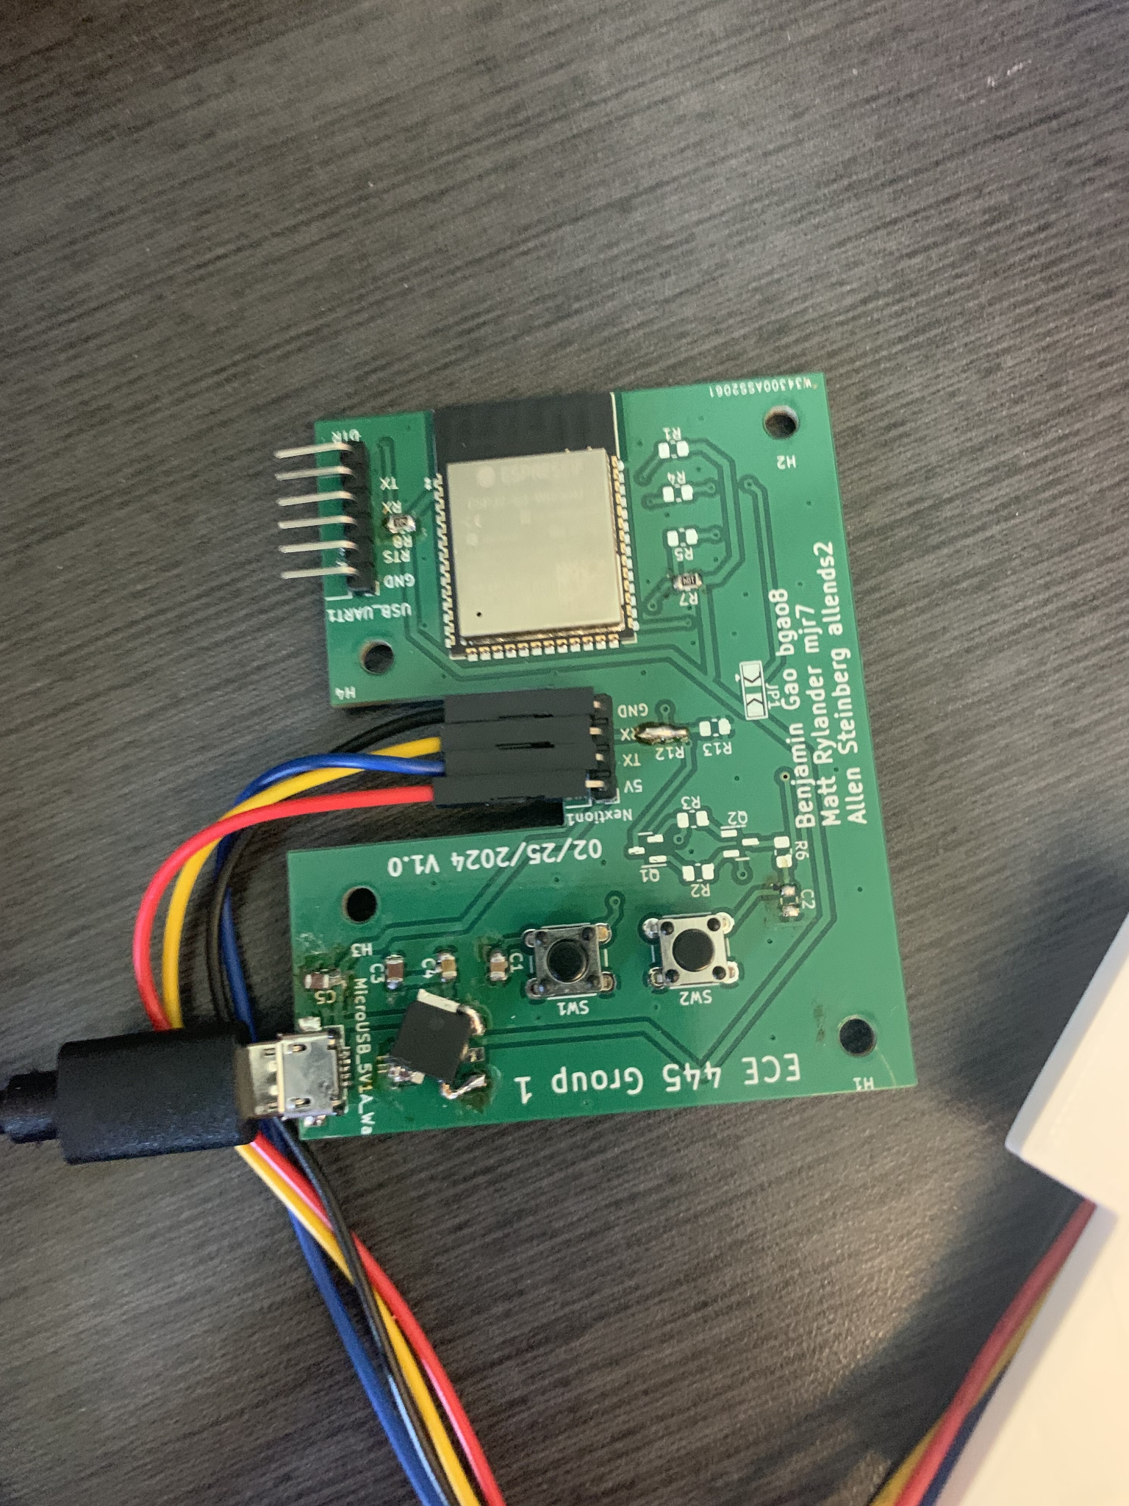
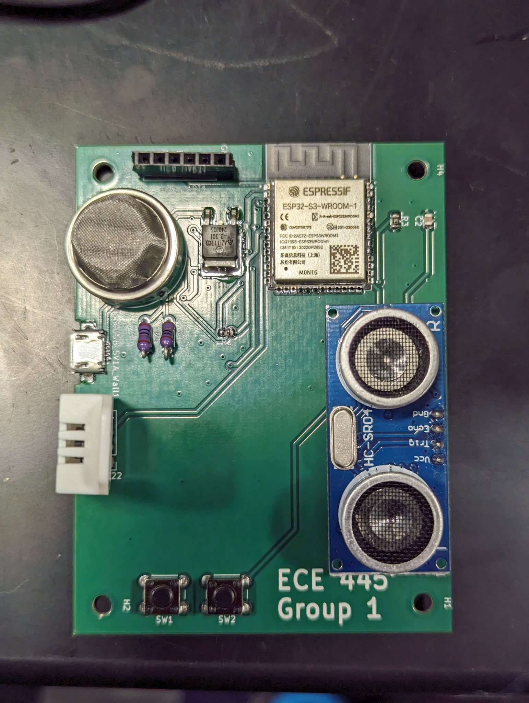
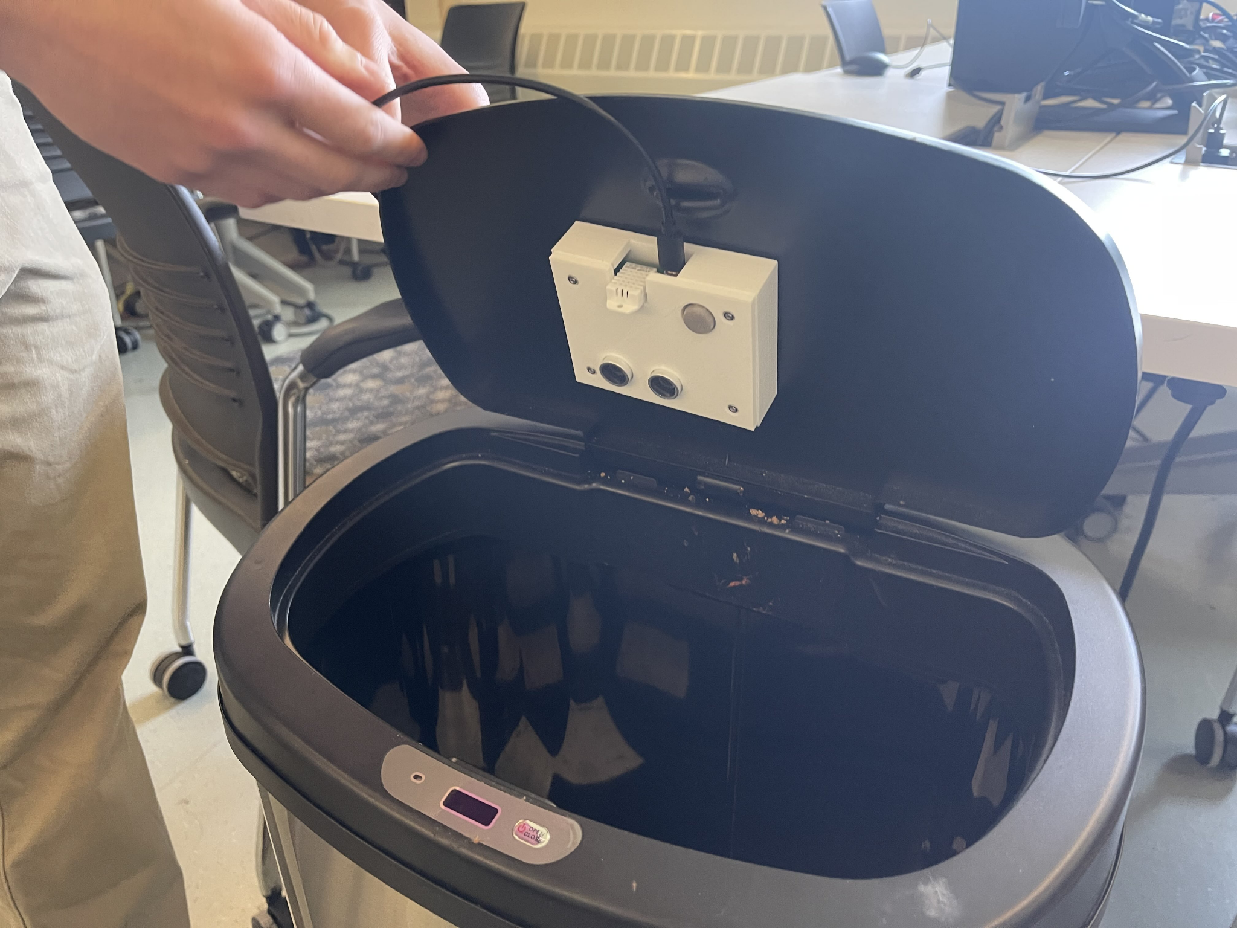
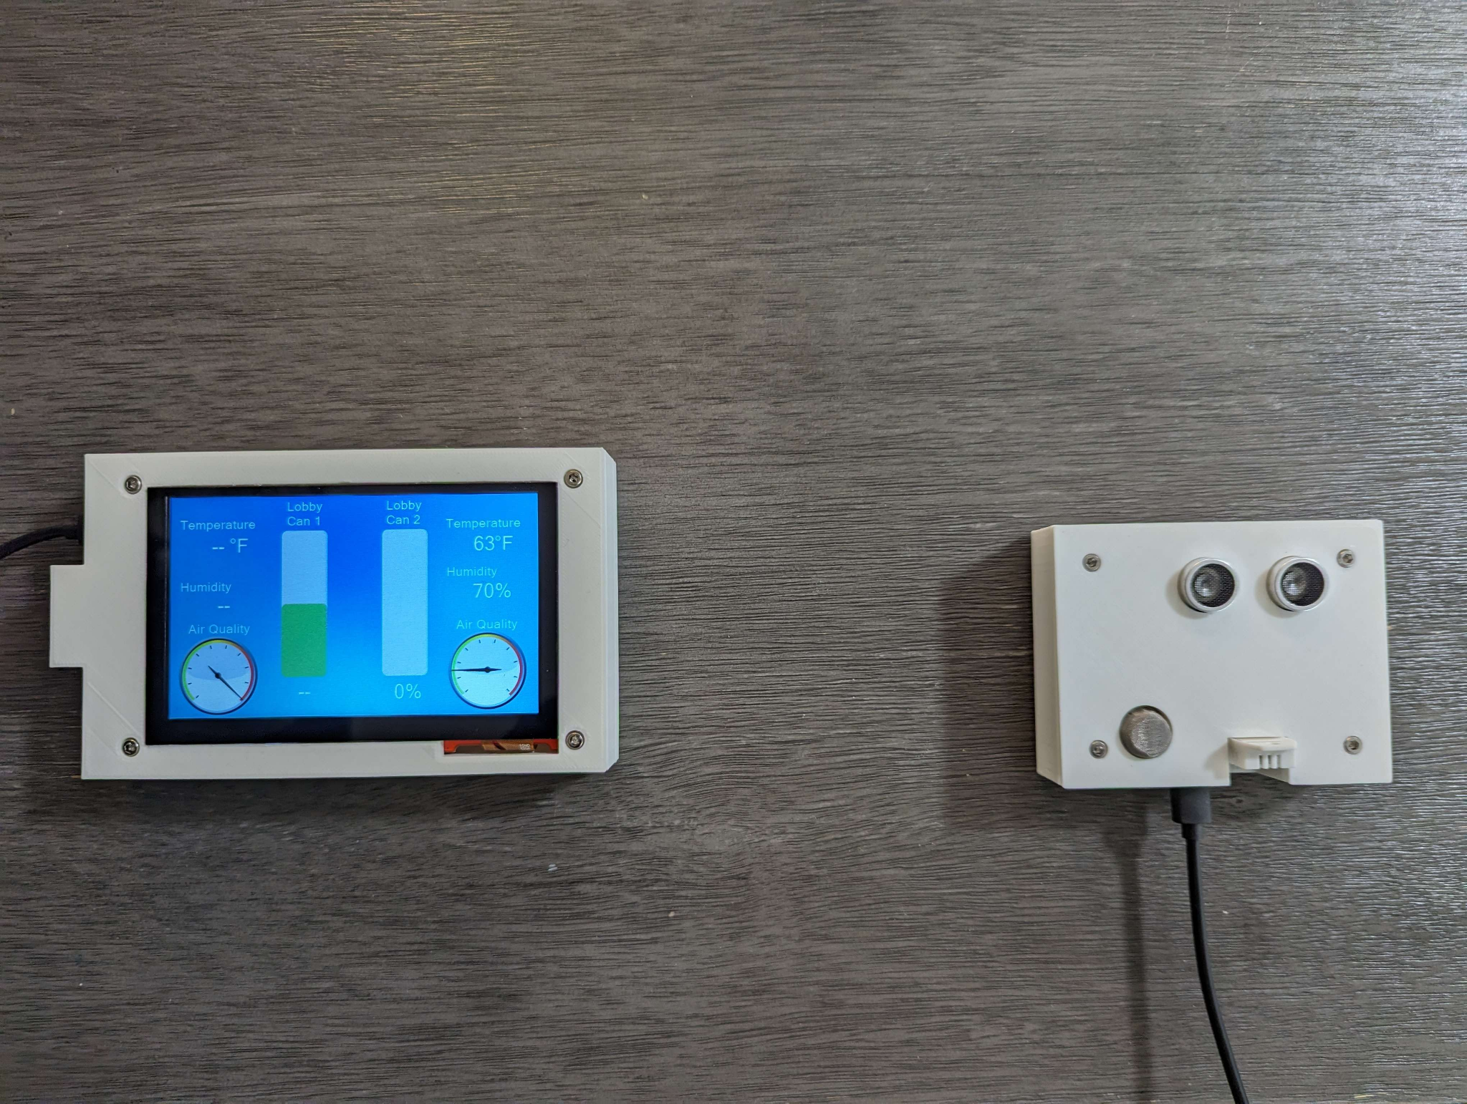
Description of Project Build, Test Results
Hub Board
Sensor Board x 2
Final Product
Notes:
Matt

Slide 9
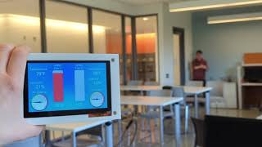

Slide 10

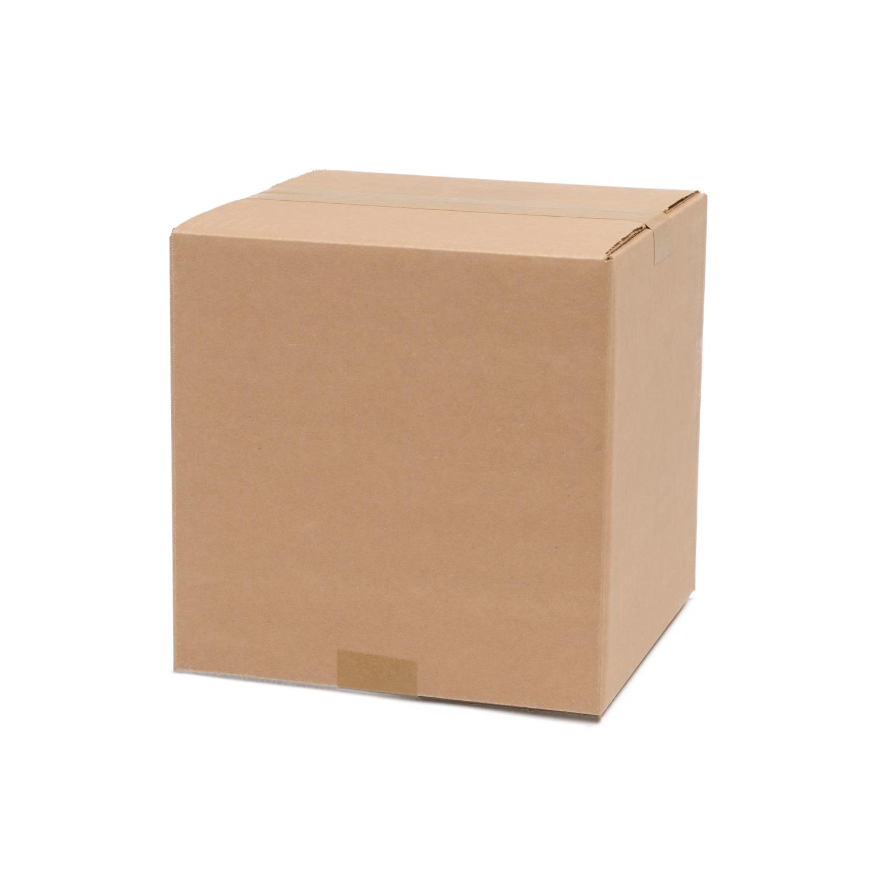
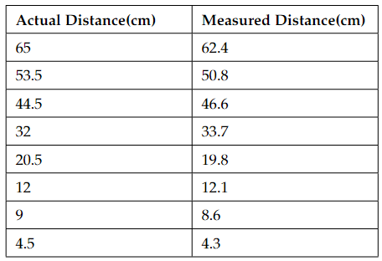
Requirements, Verifications, and Results
Ultrasonic Sensor
Requirement: +/- 5cm distance measured
Verification:
Results:
Notes:
Matt

Slide 11
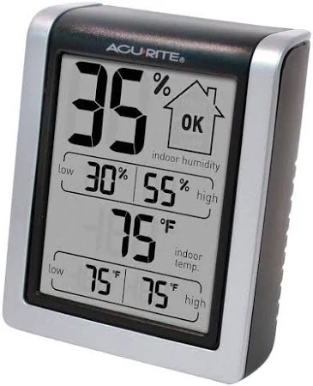
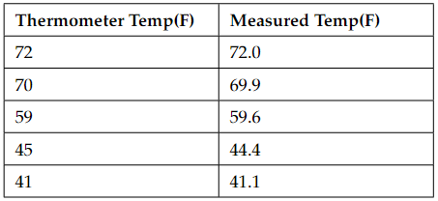
Requirements, Verifications, and Results
Temperature Sensor (DHT22)
Requirement: +/- 2°F
Verification:
Results:
Notes:
Matt

Slide 12
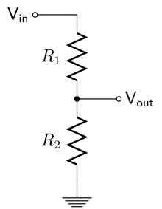
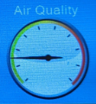
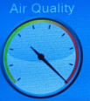
Requirements, Verifications, and Results
Gas Sensor
Requirement: detect noxious fumes (CO₂, NH₃, etc.)
Verification: >100 change in analog reading (0.08V) due to exhale
Results: >450 (>0.36V) change observed
Notes:
Allen
Landfill gas - half CO2, some NH3 as well

Slide 13
Requirements, Verifications, and Results
Microcontroller Systems
Requirement: send/receive data within 10 seconds
Verification: measure response time
Results: <2 seconds
Notes:
Allen

Slide 14
Requirements, Verifications, and Results
Power Systems
Requirement: Step input 5V from USB to 3.3 +- 0.3V
Verification: Measurements with multimeter
Results: Steady voltage levels at around 3.3 +- 0.1V
Notes:
Ben

Slide 15
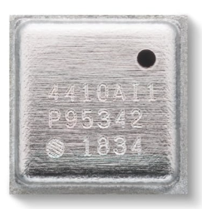
Challenges
Gas sensor choice and calibration
ESP32 soldering and programming
Sensor board heat generation
Notes:
Allen
ZMOD: well-documented IAQ index; very complex and unclear software component, too small for quick airflow
MQ135: less precise measurement; simpler to set up, quicker response to air quality
ESP32 damaged by heat gun at first, had to use oven for more appropriate soldering process

Slide 16
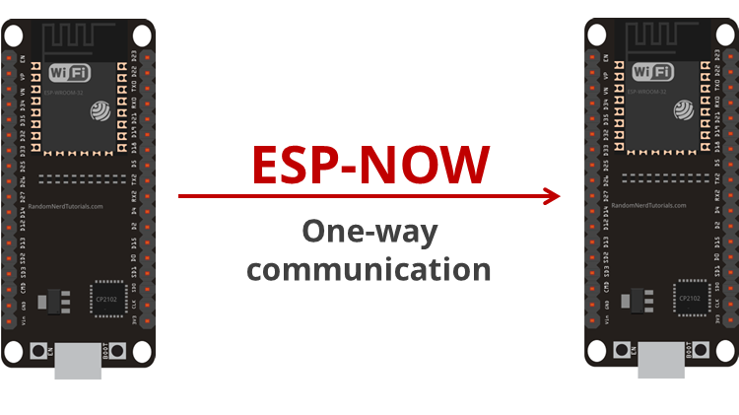
Successes
ESPNOW protocol
Sensor accuracy
Ultrasonic: < 1 inch precision
Gas sensor: ~1000 ppm sensitivity
Functioning PCBs
Notes:
Allen
ESPNOW: useful peer-to-peer protocol for wireless communication without WiFi
Typical precision in trash level < ¼ inch (based on stable level reading)
Gas sensor reading as displayed maxes out when exposed to breath (~40000 ppm) → indicates sensitivity in the range of 1000 ppm
Working PCB

Slide 17


Ethical Considerations
Privacy:
Devices gathering data in public areas
What kind of data is collected and tracked?
Safety:
Our product is not a hard rule for changing trash
Splash safety for electronics
Notes:
Matt

Slide 18


Conclusions from the Project
Conclusions:
Product addresses specific issue
Balancing complexity with convenience
Wifi
Battery power
Notes:
Ben
Conclusions from the project: what did you learn, what would you do differently if you redesigned your project, etc.

Slide 19
Recommendations for Further Work
Reduced height/form factor
Battery system for buffer in power outages
Balance price point and size vs features
Notes:
Ben

Slide 20
Recommendations for Further Work
(cont.)
Additional Sensors
Recalibration
Improved UI
Notes:
Matt

Slide 21
Thank You!

